Slide 1
CREATE
Reservation system
2015041068 Jeong Min Gyu
2015041062 Heo Ji Yong
2015041070 Kim Il Hwan

Slide 2
1. Team and roles
2. Idea
3. Requirement analysis
4. E-R Diagram
5. Database
6. Tuning
7. Queries
8. Application
9. Demo
10. Conclusion

Slide 3



1 Team and roles
1
2
3
Heo Ji Yong
Jeong Min Gyu
Kim il Hwan
Web design
Function implementation
DB design
Data Processing
Data Insertion
DB connect (PHP)
Function implementation

Slide 4
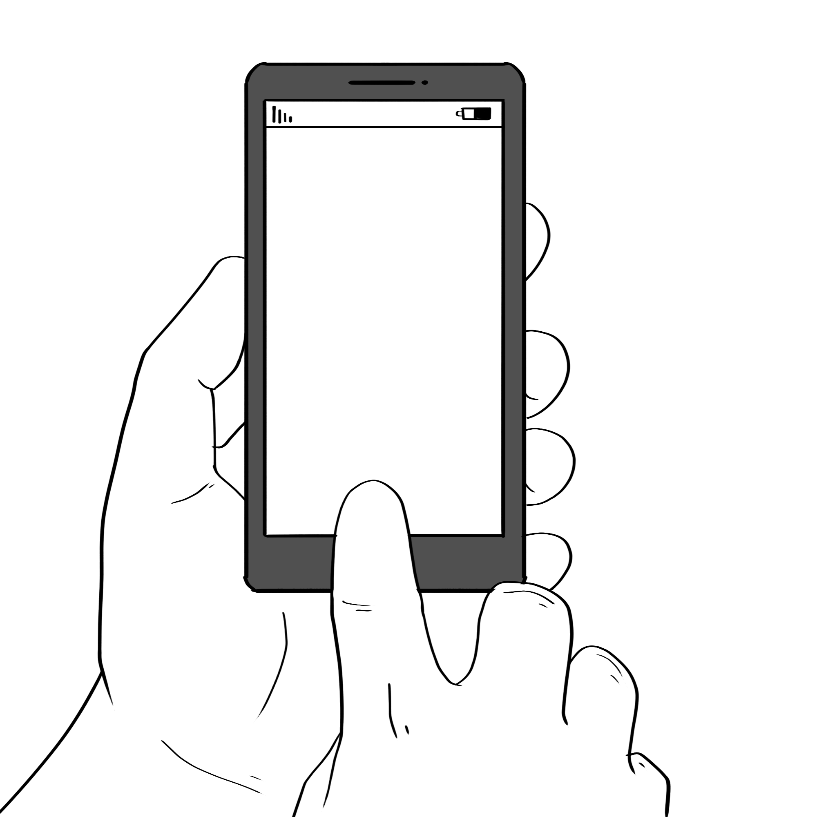


2 Idea
Why this idea is important

Slide 5

3 Requirement Analysis
One hair designer can write one announcement.
One hair designer can manage several hair designers.
One hair designer can be managed by one hair designer.
One hair designer can post several SNS promotions.

Slide 6
3 Requirement Analysis
One hair designer can be booked for multiple services.
One hair designer can be booked several members
One service can be booked by several members.
One service can be booked by several hair designers.

Slide 7
3 Requirement Analysis
One member can write several comments.
One member can book several hair designers.
One member can book several services.
One member can request several items.
The items can ask several members of one.

Slide 8
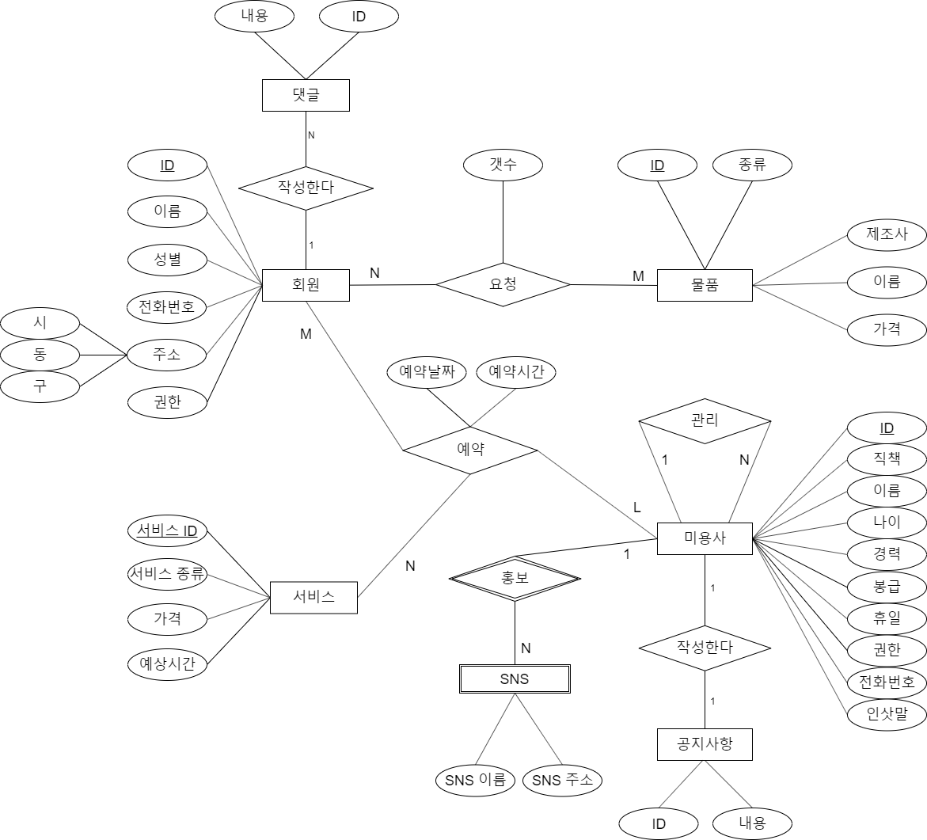
4 E-R Diagram

Slide 9
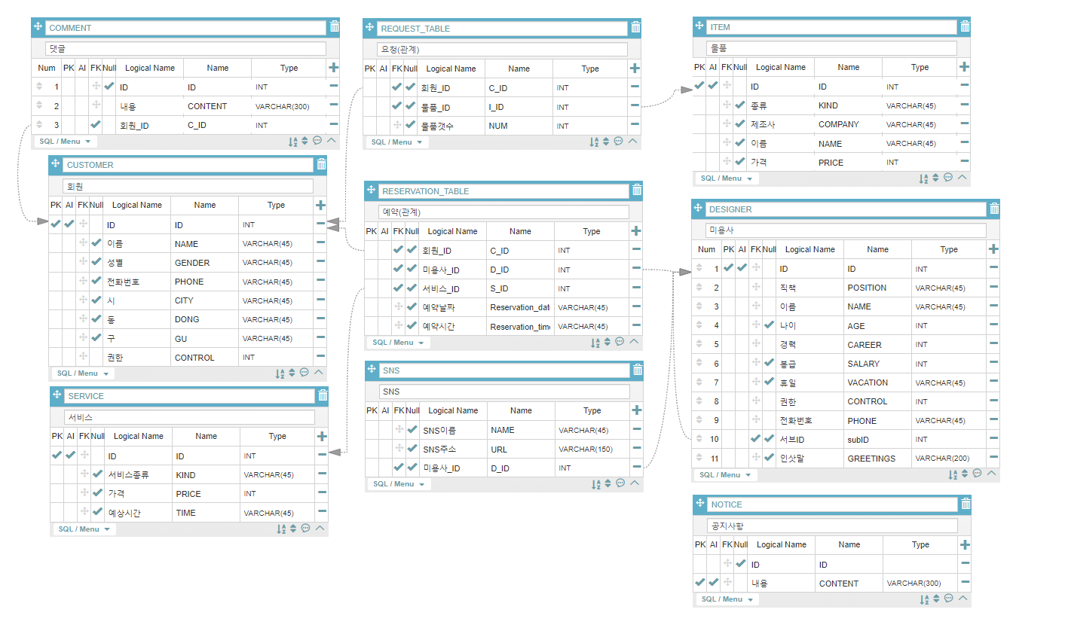
5 Data Base
Table

Slide 10
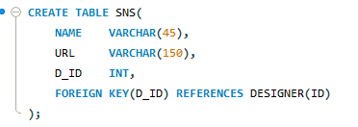
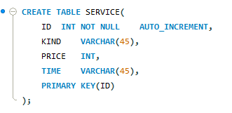
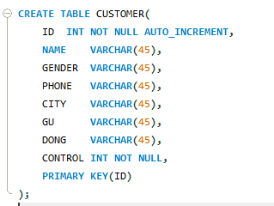
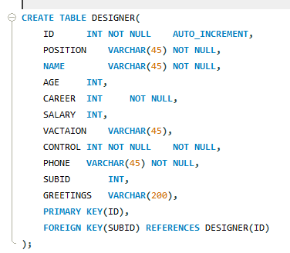
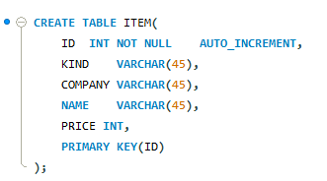
5 Data Base
Table

Slide 11
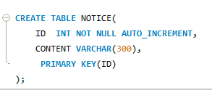
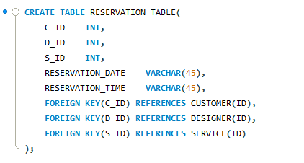
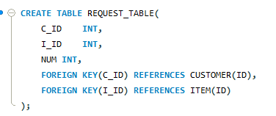
5 Data Base
Table

Slide 12
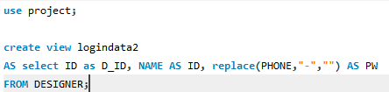
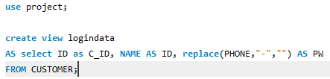
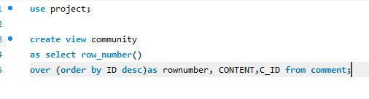
5 Data Base
View

Slide 13
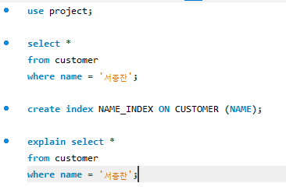
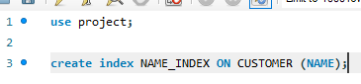
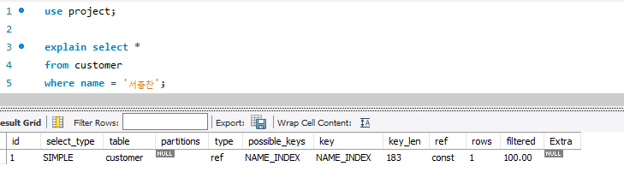
6 Tuning
Indexing

Slide 14
7 Queries
1. select content from notice order by ID desc
Print the most recent announcement on the bulletin board
2. select * from service where ID = n
Information output based on service ID
3. select content from community where rownumber=1;
Output most recently entered comment information
4. create view community as select row_number() over (order by ID desc)as rownumber,
CONTENT,C_ID from comment;
Create a Save View of the most recent comments you've typed in order

Slide 15
7 Queries
5. select name from customer
where id=(select c_id from community
where rownumber=1);
Match the id of the comments to the name output
6. select content from community where rownumber=2;
Last 2nd saved comment output
7. select * from designer WHERE ID = 1;
Name matches to print hairstyle
8. select * from logindata2 where ID='$id’
Information confirmation output at login

Slide 16
7 Queries
9. insert into comment (content,c_id) select '$content',c.id from customer as c
where c.name = '$name’;
Save the ID and the contents of the comment you entered.
10. insert into notice (content) values('$content’)
Enter notice
11.insert into request_table(C_ID,I_ID,NUM)
SELECT C.ID,I.ID,$num
FROM CUSTOMER AS C, ITEM AS I
WHERE C.NAME = '$name' AND I.ID=$index;
Save required information when requesting items

Slide 17
7 Queries
12. select * from logindata2 where ID='$id’
Check information when logging in
13. insert into customer (NAME, GENDER, PHONE, CITY, GU, DONG,CONTROL)
values ('$NAME', '$GENDER', '$PHONE', '$CITY', '$GU', '$DONG','$CONTROL’)
Enter required information when registering as a member

Slide 18
8 Application
01
HTML, CSS, JS,
Bootstrap, Jquery
02
MySQL, XAMPP, PHP
03
Python, C++
Notes:
사용한 언어들 –
Mysql
Php
Html css js Bootstrap Jquery
Xampp
Python
C++
HTML CSS JS Bootstrap Jquery : 데이터의 시각화 및 저장을 위한 인터페이스 제공
MySQL ,XAMPP, PHP : DB와 웹을 연결하기 위한
Python : 필요한 데이터 크롤링, 수집을 위함
C++ : 수집한 데이터를 Mysql에 넣을수 있게 쿼리문으로 가공하기위함.

Slide 19


8 Application
HTML, CSS, JS, Bootstrap, Jquery
MySQL, XAMPP, PHP
Notes:
사용한 언어들 –
Mysql
Php
Html css js Bootstrap Jquery
Xampp
Python
C++
HTML CSS JS Bootstrap Jquery : 데이터의 시각화 및 저장을 위한 인터페이스 제공
MySQL ,XAMPP, PHP : DB와 웹을 연결하기 위한
Python : 필요한 데이터 크롤링, 수집을 위함
C++ : 수집한 데이터를 Mysql에 넣을수 있게 쿼리문으로 가공하기위함.

Slide 20
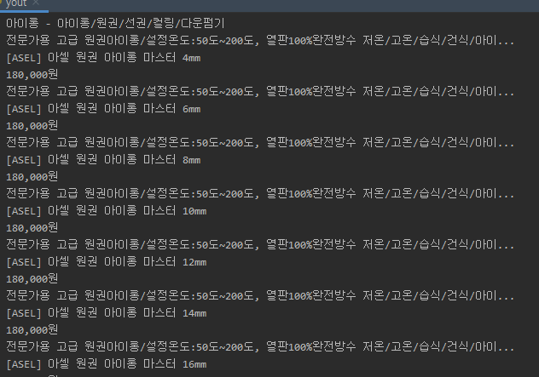
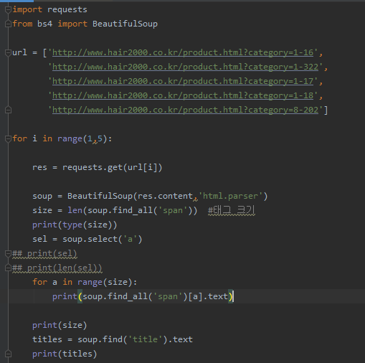


8 Application
Python, C++
Web Crawler
Notes:
사용한 언어들 –
Mysql
Php
Html css js Bootstrap Jquery
Xampp
Python
C++
HTML CSS JS Bootstrap Jquery : 데이터의 시각화 및 저장을 위한 인터페이스 제공
MySQL ,XAMPP, PHP : DB와 웹을 연결하기 위한
Python : 필요한 데이터 크롤링, 수집을 위함
C++ : 수집한 데이터를 Mysql에 넣을수 있게 쿼리문으로 가공하기위함.

Slide 21
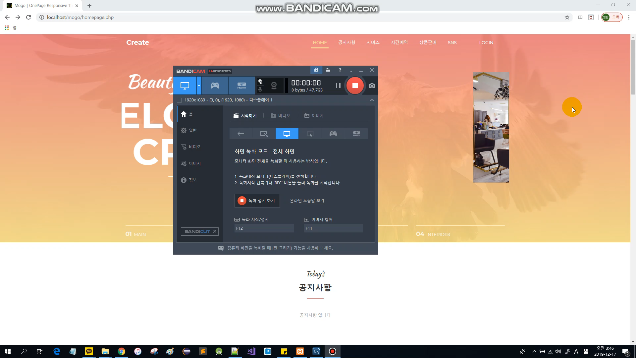
9 Demo

Slide 22
10 ConClusion
It was good to be able to apply
what we learned in real life.
We hope that the technology
we learned will help us in real life.

Slide 23
Thank you

